Slide 1
Suicide Rates Overview
From 1985 to 2016
Group 2
Tina
First year of graduate school/ Electronic Engineering
Justin
Sophomore/ Electronic Engineering
Jarwy
Sophomore/ Electronic Engineering

Slide 2
Outline
Data
Data Preprocessing
Visualization
Model
Result

Slide 3
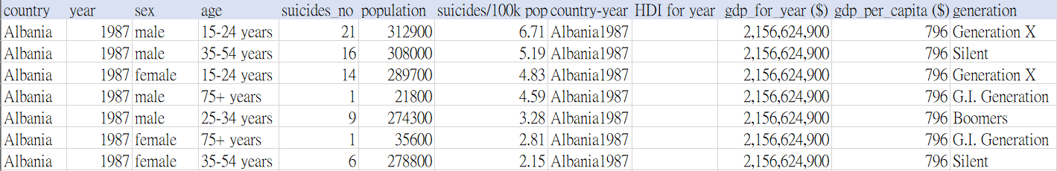
Data (Original Columns)
Data
Data Preprocessing
Visualization
Model
Result
The number of people who killed themselves
Range from 1985 to 2016 (31 years)
Suicides number per 100k people
There are 101 different countries in our dataset.
Five age groups (5-14 years, 15-24 years, 25-34 years, 35-54 years, 55-74 years and 75+)
Two sexes for sure.
Population
Data Source: Kaggle(https://www.kaggle.com/russellyates88/suicide-rates-overview-1985-to-2016)

Slide 4
Data (Original Columns)
Data
Data Preprocessing
Visualization
Model
Result
Data Source: Kaggle(https://www.kaggle.com/russellyates88/suicide-rates-overview-1985-to-2016)

Slide 5
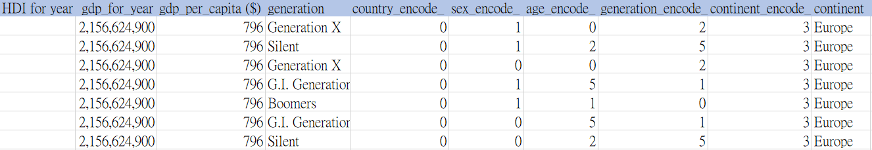
Data (Original Columns)
Data
Data Preprocessing
Visualization
Model
Result
GDP per capita($)
Generation
Data Source: Kaggle(https://www.kaggle.com/russellyates88/suicide-rates-overview-1985-to-2016)

Slide 6
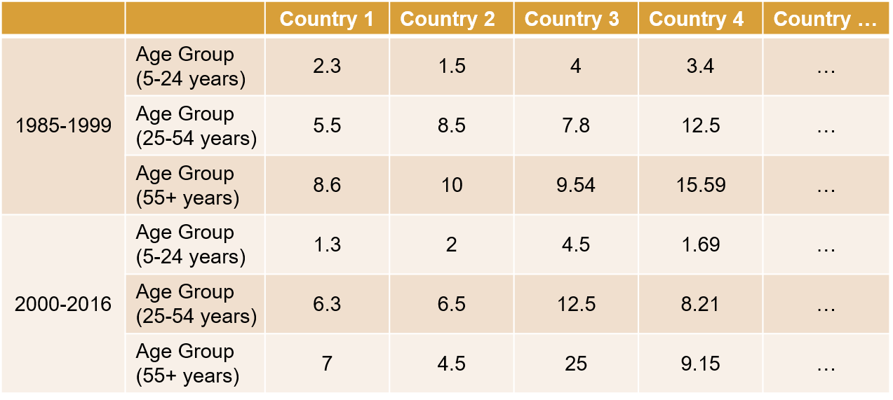
Data
Data Preprocessing
Visualization
Model
Result
Data Preprocessing
Data Preprocessing
We labeled continents to each country and encoded countries,
sexes, age groups and generations.
We put countries and their attributes into SOM.

Slide 7
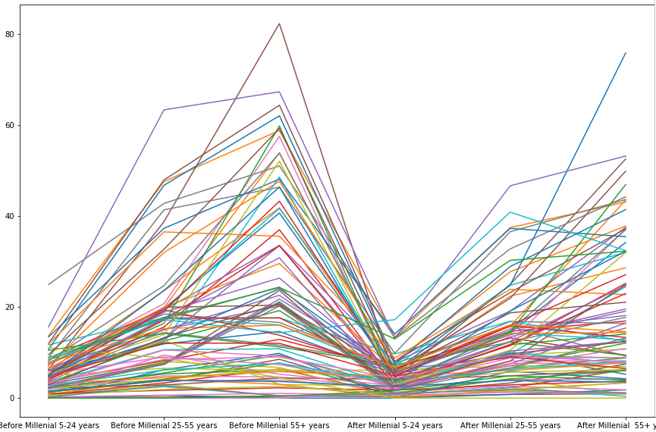
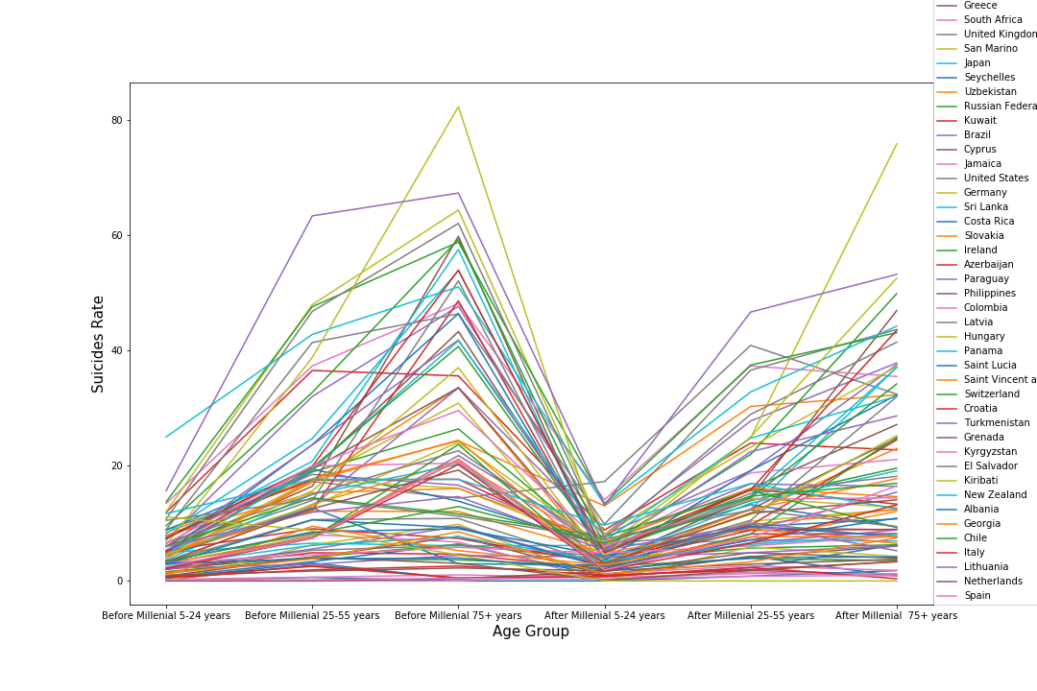
Data
Data Preprocessing
Visualization
Model
Result
Visualization
Suicide Rate
Age Group

Slide 8
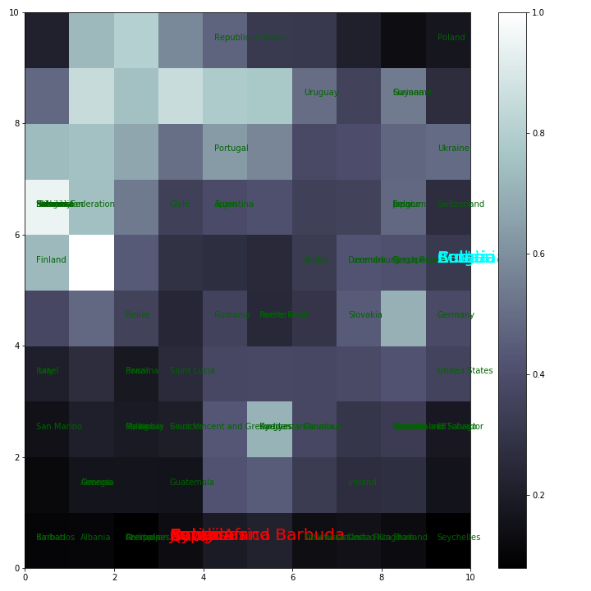
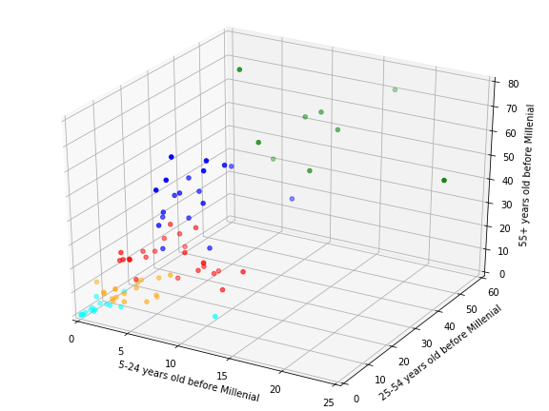
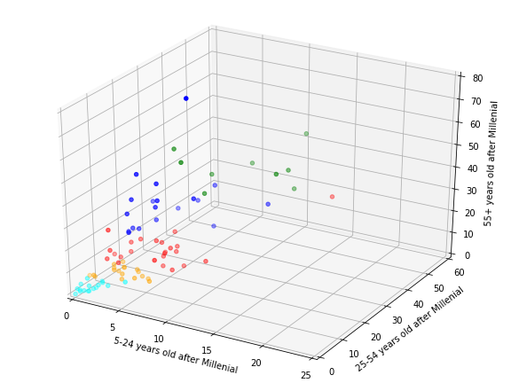
Data
Data Preprocessing
Visualization
Model
Result
Our Model (K-Means)
Our Model (K-Means)
Our Model (SOM)
Before Millennial
After Millennial

Slide 9
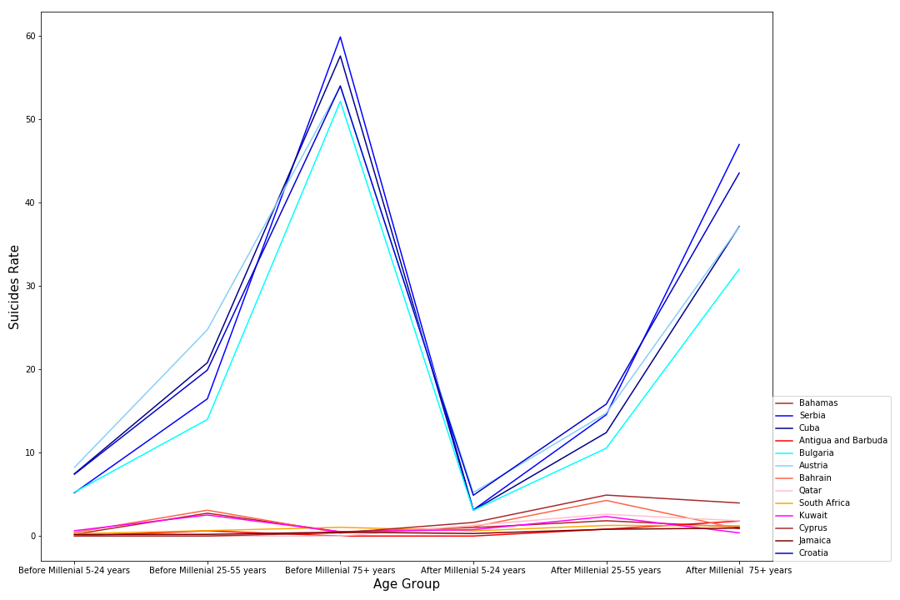
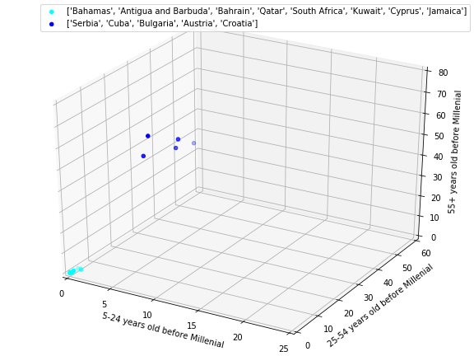
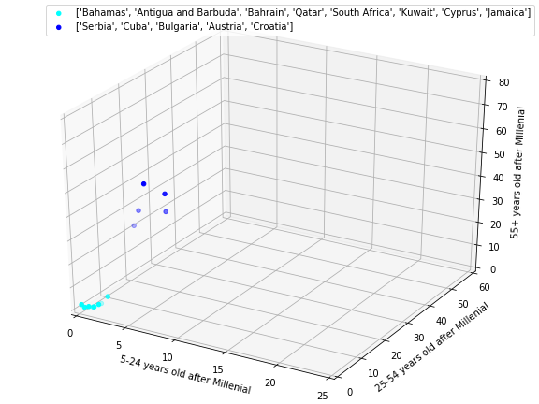
Data
Data Preprocessing
Visualization
Model
Result
SOM
K-Means

